Slide 1


Generating Multi-scale Graphs with Graph U-Net
Department of Software Engineering Capstone Project Phase A Braude College of Engineering, Israel Project 24-1-R-9
314761065 Shahar Vachiler 205799976 Shachar Dalal
Project supervisor - Prof. Vladimir (Zeev) Volkovich
Project advisor - Dr. Renata Avros

Slide 2
Agenda
Introduction
Graph U-Nets
Model
Conclusion

Slide 3
Introduction
Graph generation involves using neural networks to create mathematical structures that model relationships between objects.
This process finds wide application in fields like social network analysis, bioinformatics, recommendation systems, chemical compound generation, and traffic flow modeling.
By generating graphs that represent these systems, researchers and practitioners can gain valuable insights that aid in decision-making processes.

Slide 4
The problem
Capturing hierarchical relationships within graph structures can become very complexing.
Existing methods are often inefficient and suffer from many limitations.
The struggle in capturing the complex nuances might lead to incomplete representations of the underlying data.
The overall performance will deteriorate in those circumstances.

Slide 5
Our approach
To address those issues we are going to propose a model based on Misc-GAN framework architecture.
The model will use the capabilities of the GU-net model to automate the generation of multi-scale graphs.
Diffusion model for graph generation will also be integrated into our model.

Slide 6

Expected achievements
The anticipation is that the model will be able to accurately capture complex dependencies and distributions inherent in graph data.
The model will efficiently process and analyze vast graph datasets, providing a solid validation of its scalability.
The goal is to provide an accessible tool for graph generation with possible applications to citation graphs.

Slide 7
Graph U-nets
The Graph U-nets (GU-nets) is one of the famous deep graph frameworks.
The model is built in a U-shaped architecture.
The model has an encoder-decoder structure that captures complex graph structures.
The model employes gPool, gUnpool, and skip connection operations to achieve this goal.

Slide 8
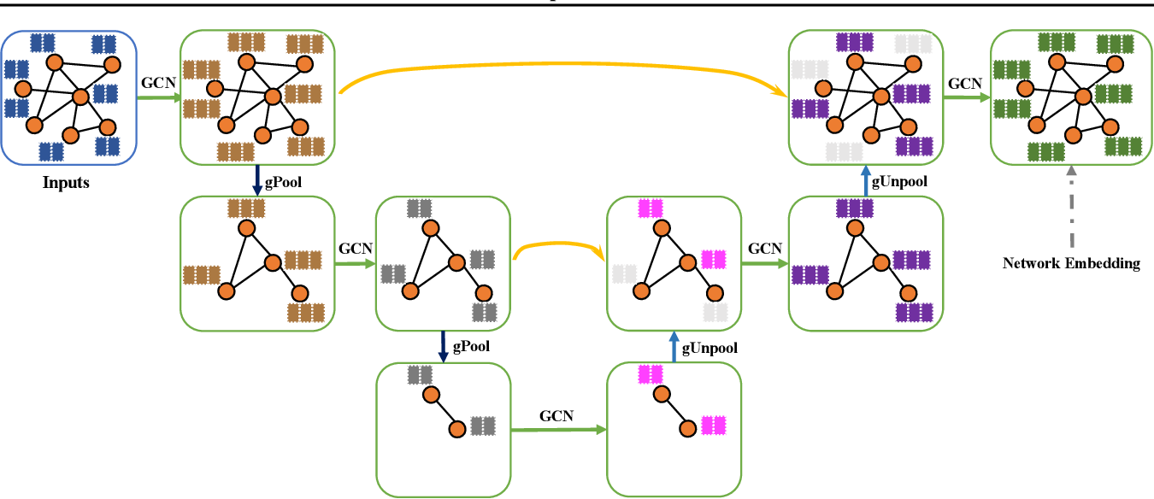
Graph U-nets

Slide 9
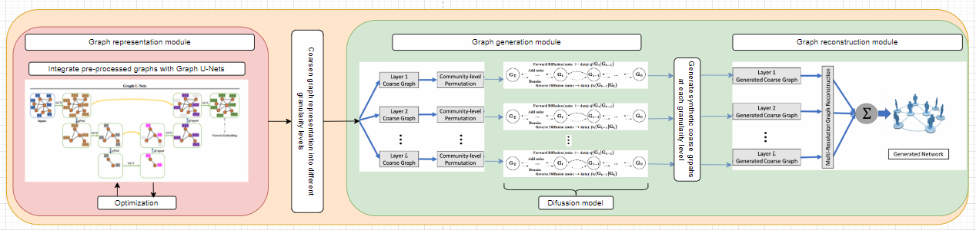
The model
The following image is the proposed model for the multi-scale graph generation using GU-net.

Slide 10
The model
Pre-process – consists of filtering data noises.
Based on the architecture of the Misc-GAN model, the project also consists of three main modules:
Graph representation module
Graph generation module
Graph reconstruction module
Testing and evaluation are used to test the output graph by means of various evaluation methods.

Slide 11
Graph representation module
The Graph Representation Module is employed in the first stage of the GU-net model, the encoder.
The model is trained on a given set of subgraphs of the predefined source graph.
Aim to refine the input graphs by the encoder process through coarsening stages and to train the model.
This process dynamically adapts to varying graph complexities, facilitating the extraction of hierarchical features.
Additionally, the output of the encoder process is a presentation of the input graph coarsened by various granularity levels.

Slide 12
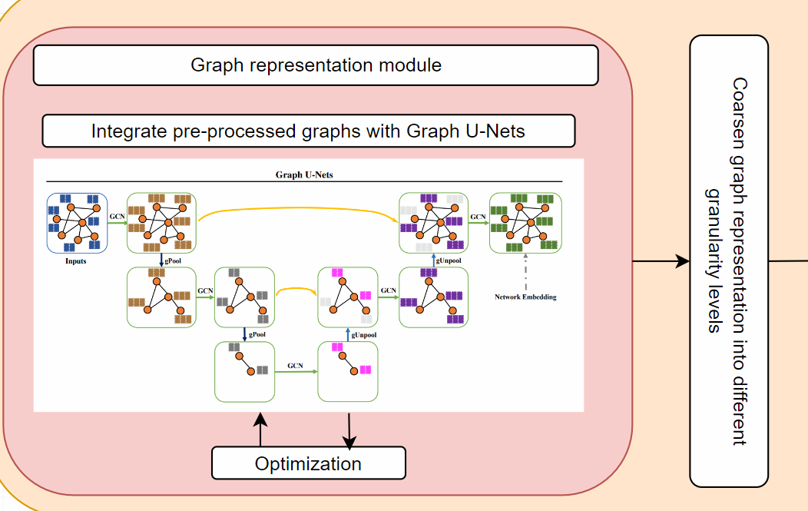
Graph representation module
In this module the graph objective is to train the model.
In this graph we have to tag the clusters.

Slide 13
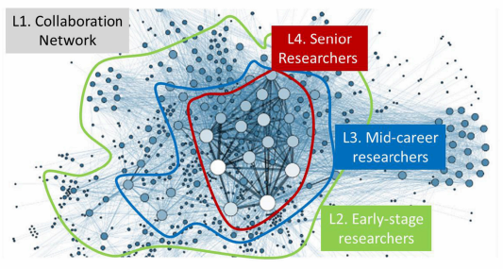
Example
This is an example represents module break down an input graph into different granularity levels:
The plot exhibits four-level hierarchies including (L1) all the entities in the collaboration network, (L2) early-stage researchers, (L3) mid-career researchers and (L4) senior researchers.

Slide 14
Graph generation module
This module facilitates the generation of target graphs from each coarsened graph at different granularity levels.
This module consist of three steps:
First step: Partitioning the graph into multiple non-overlapping subgraphs.
Second step: Characterize the community-level graph structures by Generating a set of block diagonal metrics from the detected communities.
Third step: Apply diffusion model that will generate graph from each granularity level.
As a result, the module generates various target graphs which are the base of the input of the Graph Reconstruction Module.

Slide 15
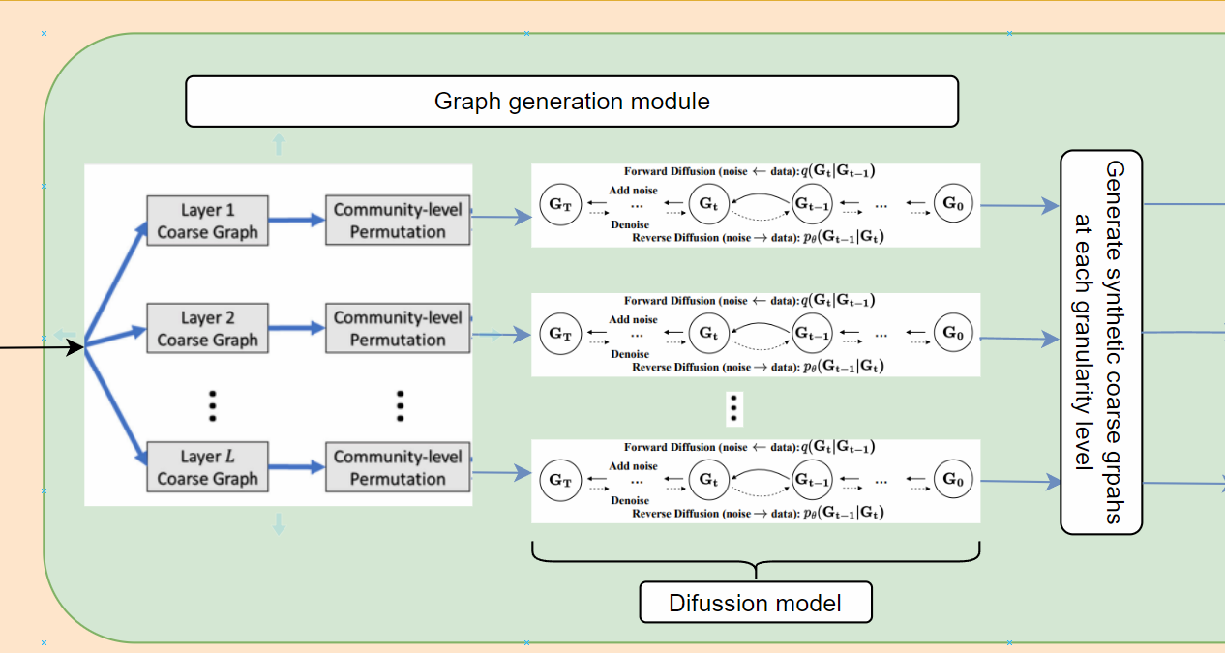
Graph generation module
Each coarsen graph is separately fed to the diffusion model.

Slide 16
Graph reconstruction module
The Graph Reconstruction Module is employed by the second stage of the GU-net model, the decoder.
The primary objective of this Module is to reconstruct a graph close to the original input graph from its coarsened representations.
Effectively reversing the coarsening operations performed during the encoding phase.
This is achieved through a combination of two key operations: gUnpool and skip connections.

Slide 17
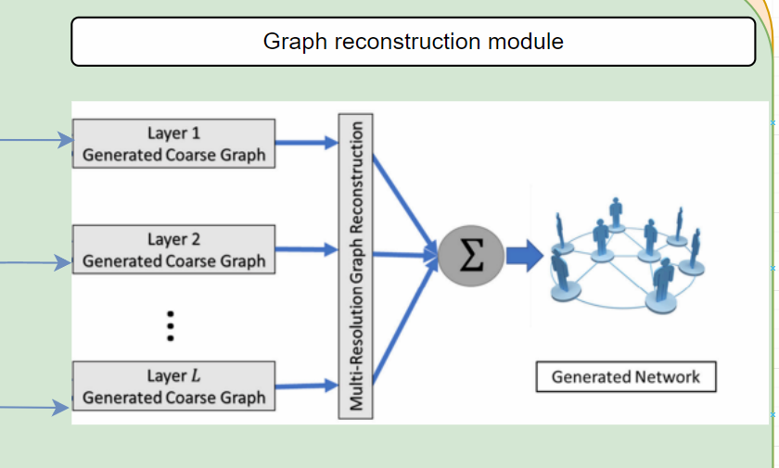
Graph reconstruction module
Combining all of the coarsen community graphs to restore the compressed graph.

Slide 18
Measuring for successes
Previous models achieved somewhere between 67% - 84% similarity.
In order for the project to be successful it needs to achieve 85% similarity between the graphs.
If the result is less than 85% the model needs to be fine-tuned and further tests will be conducted.
The model will have the ability to generalize to new datasets and its performance compared to human-generated graphs.

Slide 19
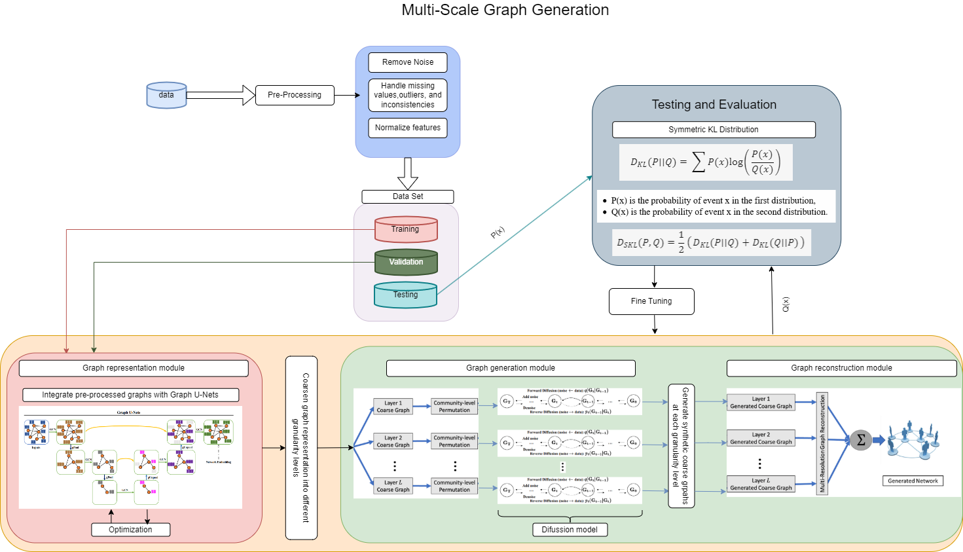
The general process
Below is the flow chart of the research model.

Slide 20
Testing plan
Test | Test Subject | Expected Result
1 | Graph Generation | The model will generate multi-scale graphs accurately based on the input.
2 | Graph Processing | The model will correctly process the generated graphs, capturing hierarchical relationships effectively.
3 | Graph Output Validation | The model will produce valid output graphs that accurately represent the hierarchical relationships in the data.
4 | Runtime Efficiency | The model will perform the graph generation and processing within an acceptable time frame.
5 | Input Size/Graph Size | The model will be able to handle larger graphs without a significant decrease in performance.
6 | Empty Graphs | If the input graph is empty, the model will return a specific error message indicating that the input graph cannot be empty. The model will not proceed with further processing until a valid graph is provided.
7 | Incomplete Graphs | If the input graph is incomplete (missing nodes or edges), the model will either return an error message or fill in the missing information based on predefined rules or assumptions.
8 | Incorrect Graphs | If the input graph is incorrect (contains invalid nodes or edges), the model will return an error message indicating the nature of the error. The model will not proceed with further processing until a valid graph is provided.
9 | Incompatible Graphs | If the input graph is incompatible with the model (for example, the graph is too large or the structure is not supported), the model will return an error message indicating the incompatibility. The model will not proceed with further processing until a compatible graph is provided.
10 | Generation Similarity Index | Similarity Index > 85%.

Slide 21
Conclusion
The incorporation of GU-Net and diffusion models offers a unique approach to capturing complex patterns within graph structures.
This incorporation enables more effective graph representation learning.
The main objective is to examine a new approach that will try to yield greater efficiency and accuracy compared to previous methods.
Through a careful testing and validation plan, the project seeks to establish the proposed model as a better solution for multi scale graph generation.

Slide 22

Thank you for listening!
Any questions?

